Slide 1
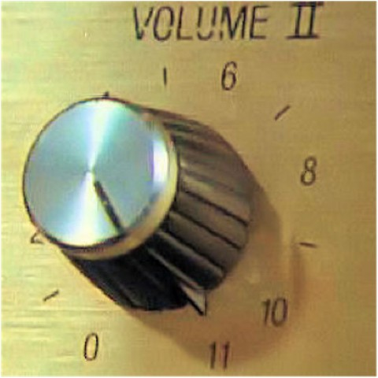

This Platform Goes to 11
Boost Developer Productivity with Lessons from Salesforce

Slide 2


About Me
Joe Kutner
DX Architect @ Salesforce
(Formerly @ Heroku)
Co-founder of Buildpacks

Slide 3
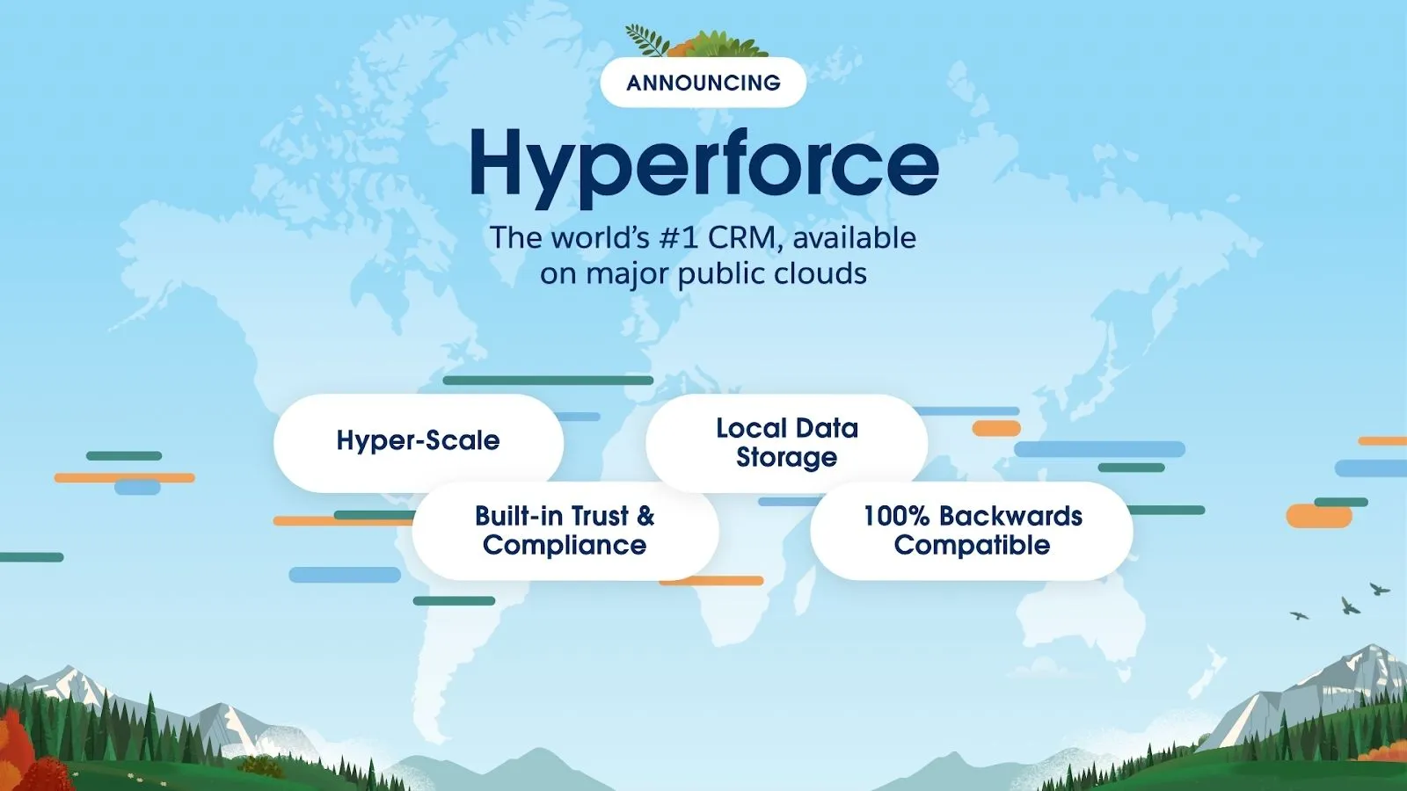
Your solution for security, compliance, accounting, credentials, regional expansion, multi-substrate …

Slide 4
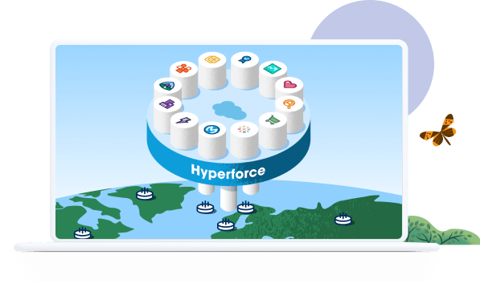


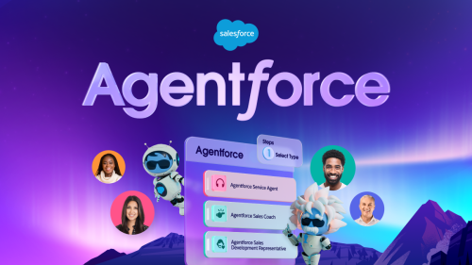
Force all the things!

Slide 5

Force all the things!
AI + Memes

Slide 6
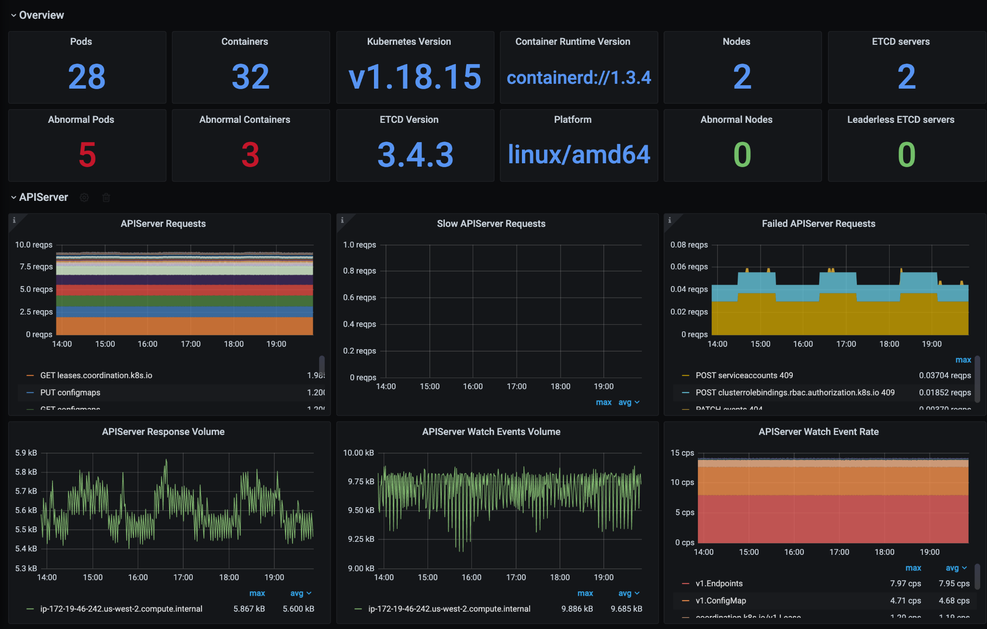
Memeforce

Slide 7

Memeforce

Slide 8

Memeforce

Slide 9
A Platform of Platforms

Slide 10






A Platform of Platforms
CI Platform
CD Platform
Terraform Platform
Kubernetes Platform
Networking Platform
Monitoring Platform

Slide 11
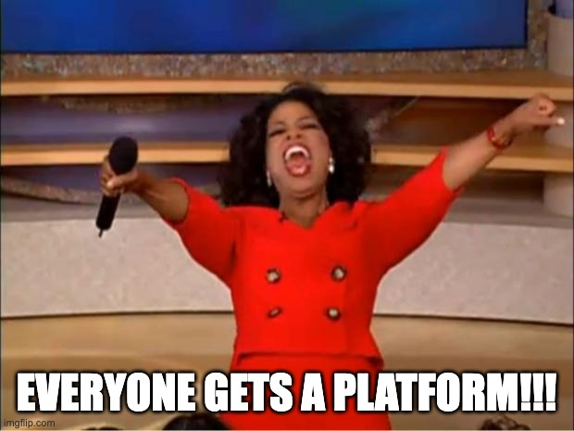

Slide 12
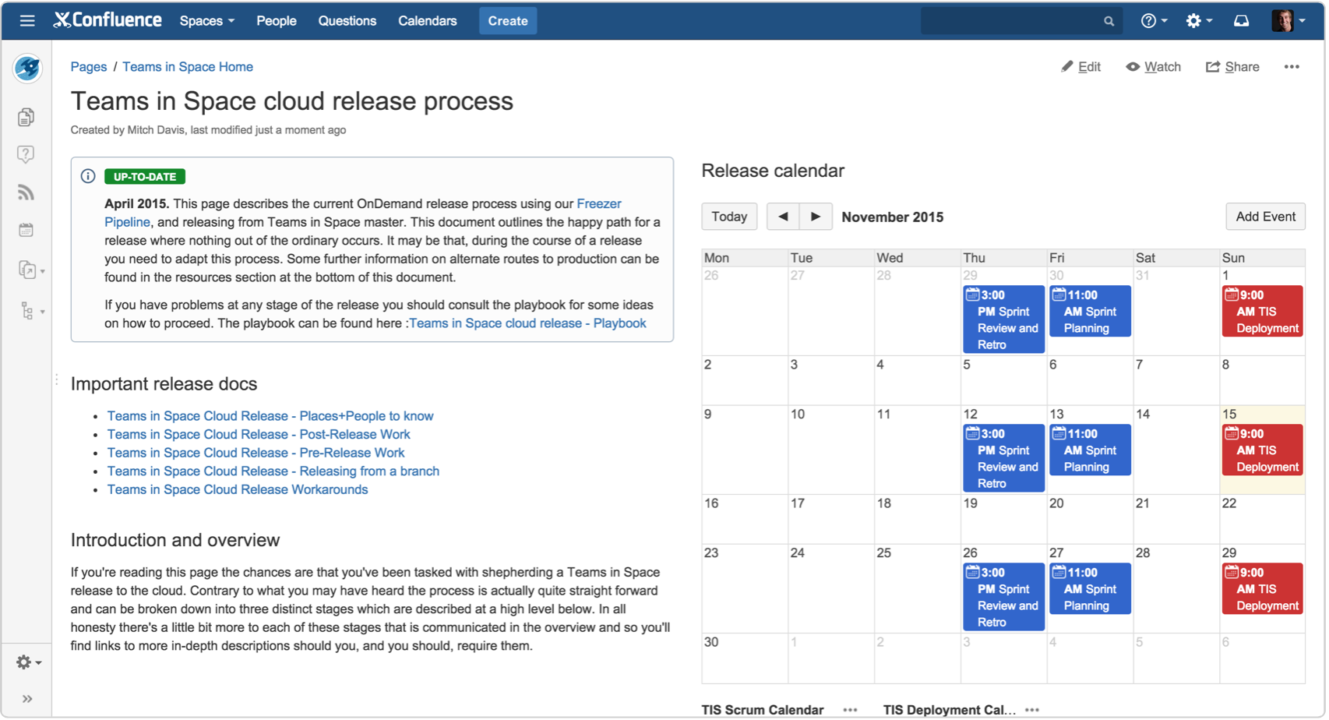
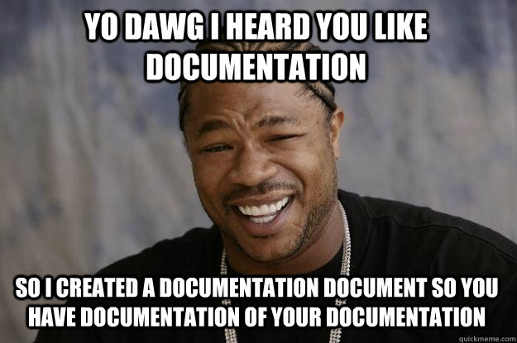
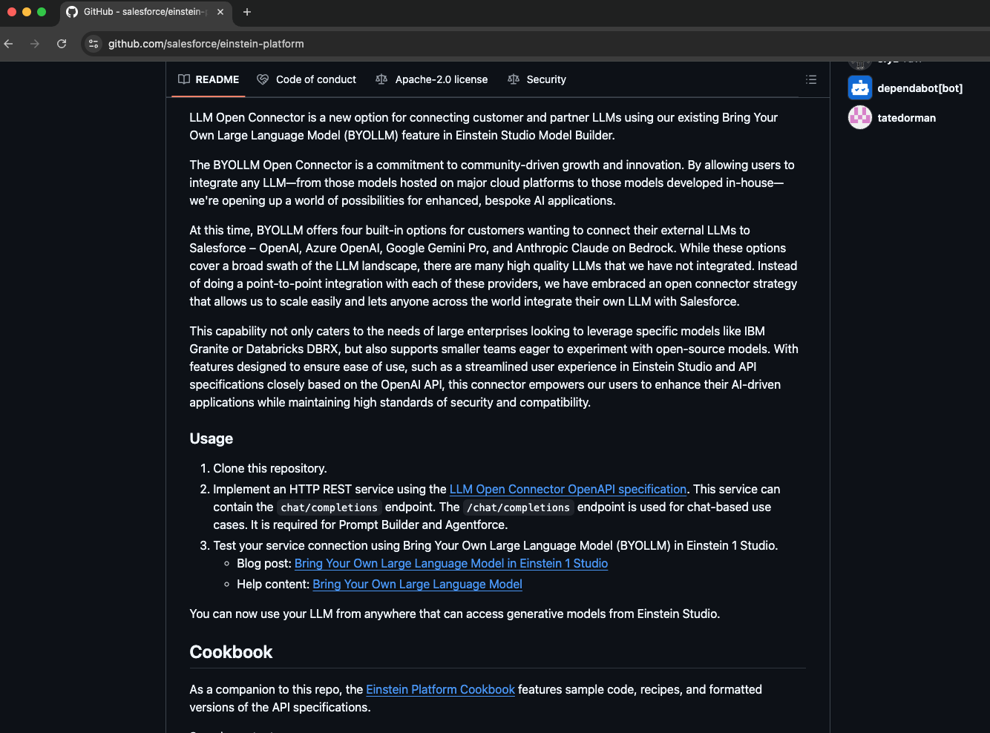
Document Driven Development

Slide 13
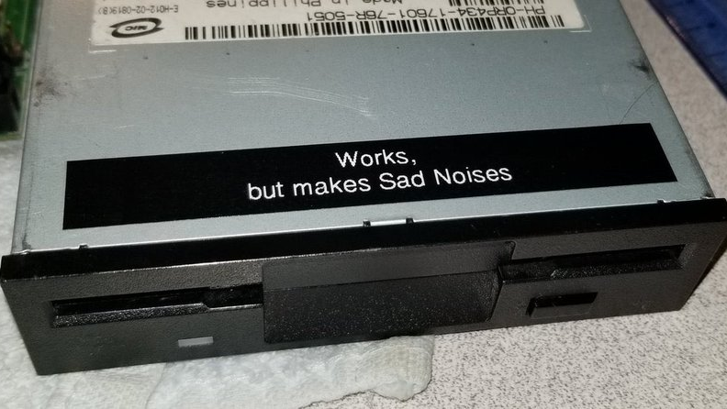

Slide 14


Slide 15
DEVELOPER PRODUCTIVITY

Slide 16
Your solution for security, compliance, accounting, credentials, regional expansion, multi-substrate …

Slide 17
Simple is Hard
Keeping it simple for developers often means making it complicated for yourself

Slide 18

Humor Engine
Fast forward a couple years. The Memeforce team needs to onboard a new service, the Humor Engine
humor
engine

Slide 19

Why Even Have a Platform?
Notes:
Memeforce wondered… if this is so hard, why didn’t we just go and build everything ourselves? It’s easy to just use AWS directly…
Every team could go build on AWS themselves

Slide 20


Why Even Have a Platform?
Notes:
Memeforce wondered… if this is so hard, why didn’t we just go and build everything ourselves? It’s easy to just use AWS directly…
Every team could go build on AWS themselves

Slide 21
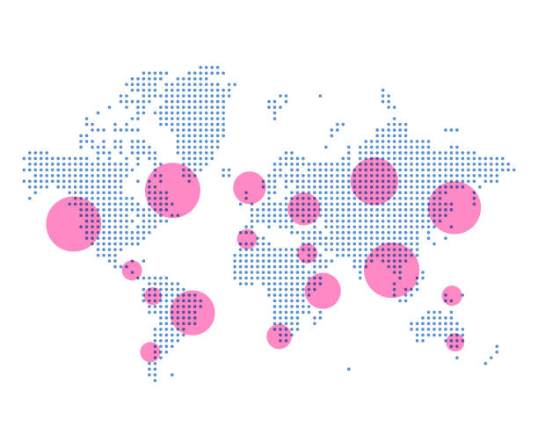




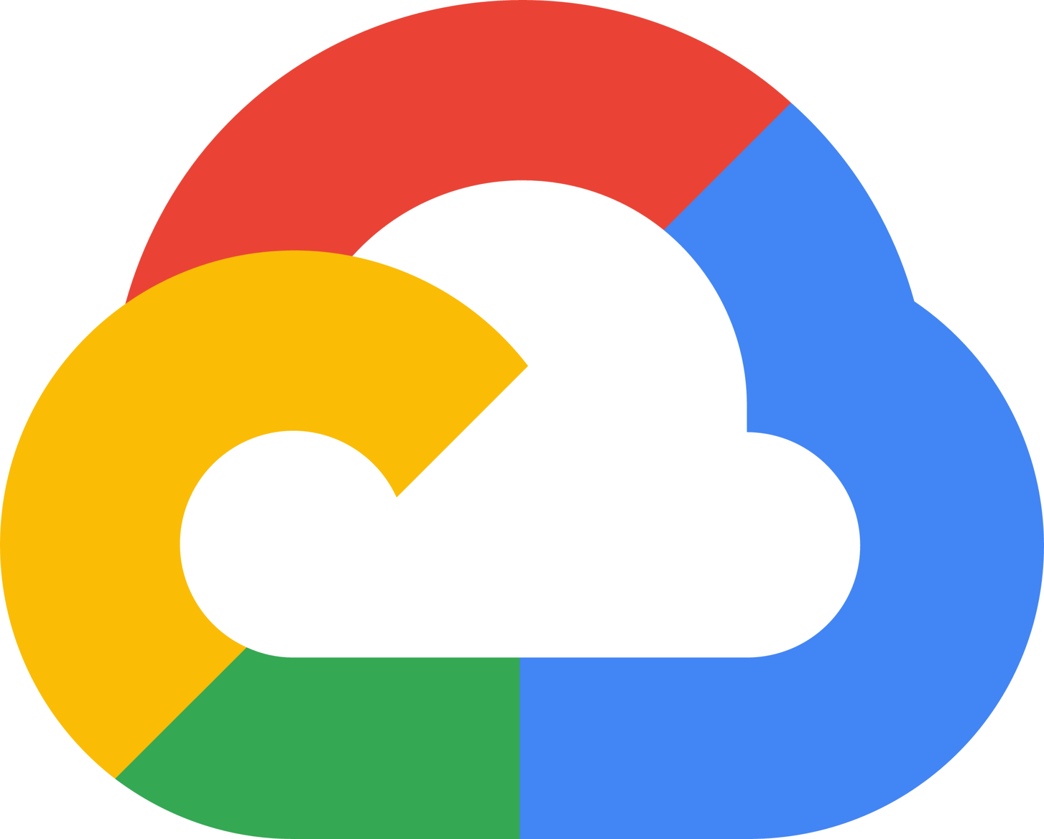

Slide 22
CJIS • TX-RAMP • EU CCoC FedRAMP • DoD IL2 • DoD IL4 DoD IL5 • NIST SP 800-171 HIPAA • HITRUST • PCI DSS ISO 27001 • ISO 27017 ISO 27018 • CSA STAR SOC 1, 2, 3 • WCAG 2.1 AA

Slide 23


Slide 24
Your solution for security, compliance, accounting, credentials, regional expansion, multi-substrate …

Slide 25
A Platform of Platforms
CI Platform
CD Platform
Terraform Platform
Kubernetes Platform
Networking Platform
Monitoring Platform

Slide 26







One Platform
CLI
GitOps
Web
Notifications
Buildpacks
Add-ons
APIs

Slide 27


Slide 28
Our Platform Principles
Unified
Interfaces
Extension
Points
Meet Developers Where They Are
Reveal Complexity Gradually
Ephemeralization
Notes:
Unified Interfaces
Extension Points
Meet Developers Where They Are
Reveal Complexity Gradually
Ephemeralization

Slide 29

Unified Interfaces
One GitOps
One CLI
One Web UI
One Notification API

Slide 30
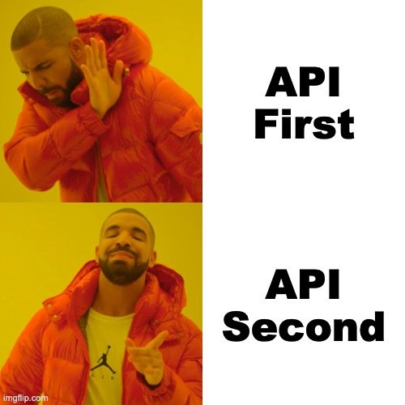
Unified Interfaces
API Second Design
(a.k.a Experience First Design)
The experience must precede everything else in the design

Slide 31
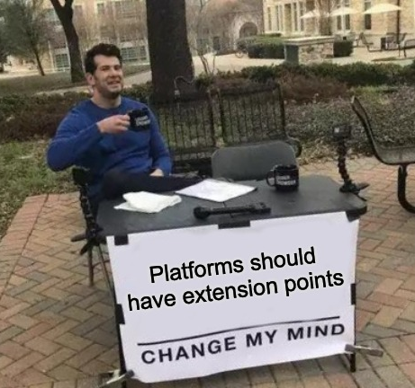
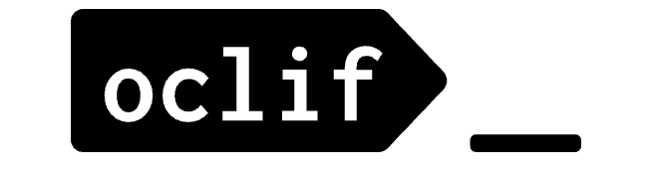
Extension Points
If it doesn’t have extension points, it’s not really a platform.
CLI Plugins
Buildpacks
Notifications API
Add-ons (eg. Heroku)
Notes:
Just like iOS platform… apps extend with common interface. Ultimately allows end users to focus on WHAT not HOW
https://github.com/hashicorp/go-plugin
https://oclif.io/
https://elements.heroku.com/

Slide 32
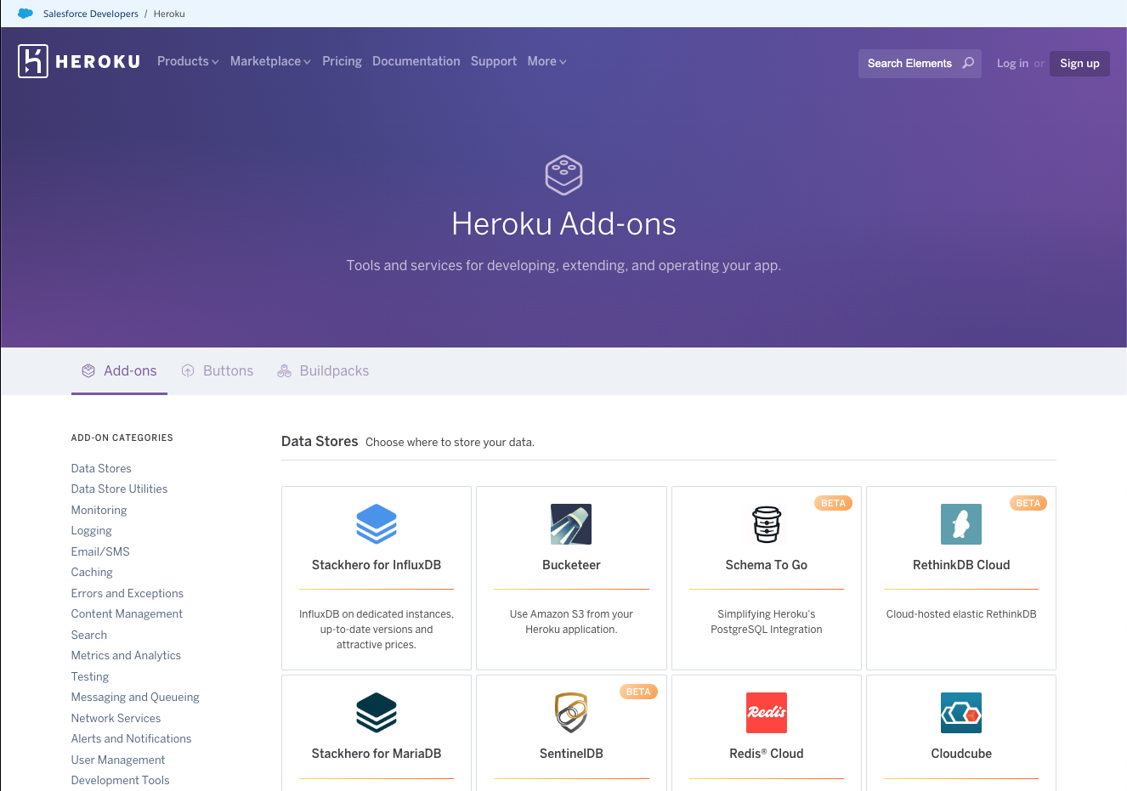
Example: Heroku Add-ons
Notes:
https://elements.heroku.com/

Slide 33
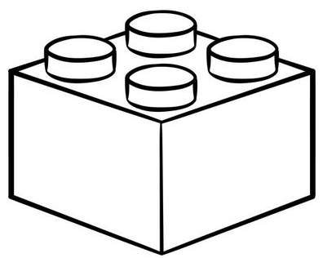


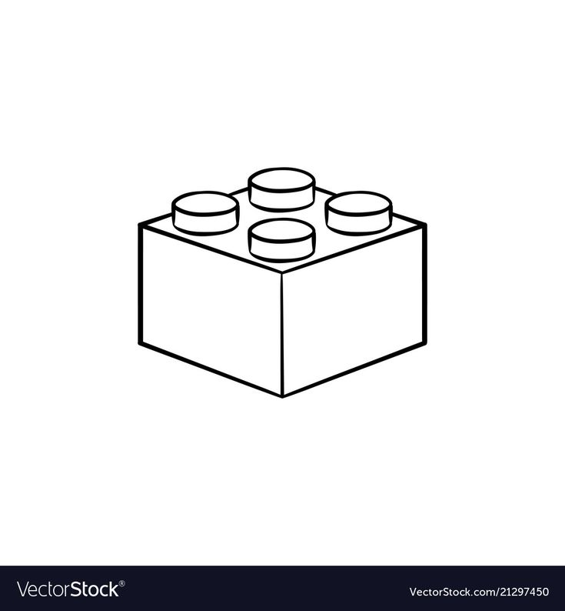

Example: Add-ons
Provisioning
Patching
Managed
k8s
Availability
Release
CD
Managed
Kafka
Security
Upgrades
Alerting
Monitoring
S3
Scaling
Decomm
Add-Ons
A way to leverage modules that encapsulate service ownership concerns
SQS
RDS

Slide 34
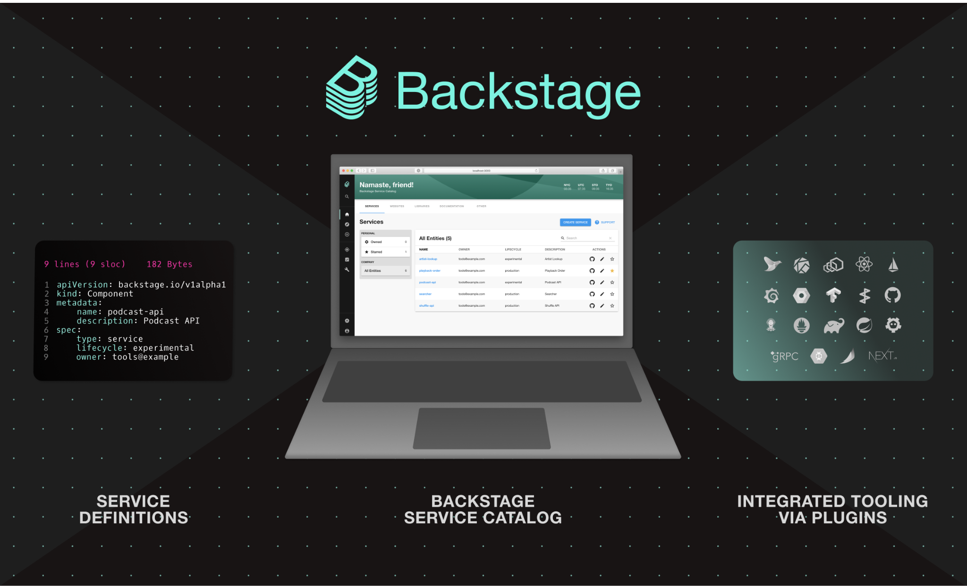
Example: Backstage

Slide 35
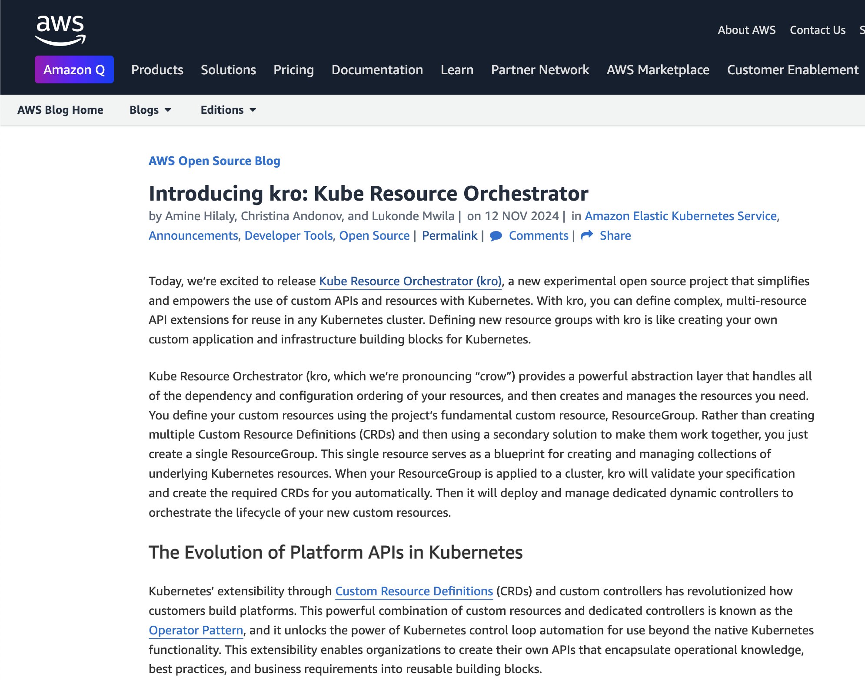
Extension Points
“This new resource encapsulates all the necessary resources for a base web application environment, including Deployments, Services, monitoring agents, and managed cloud resources like Amazon Simple Storage Service (Amazon S3) buckets or Amazon Simple Queue Service (Amazon SQS) queues.”
https://github.com/awslabs/kro

Slide 36
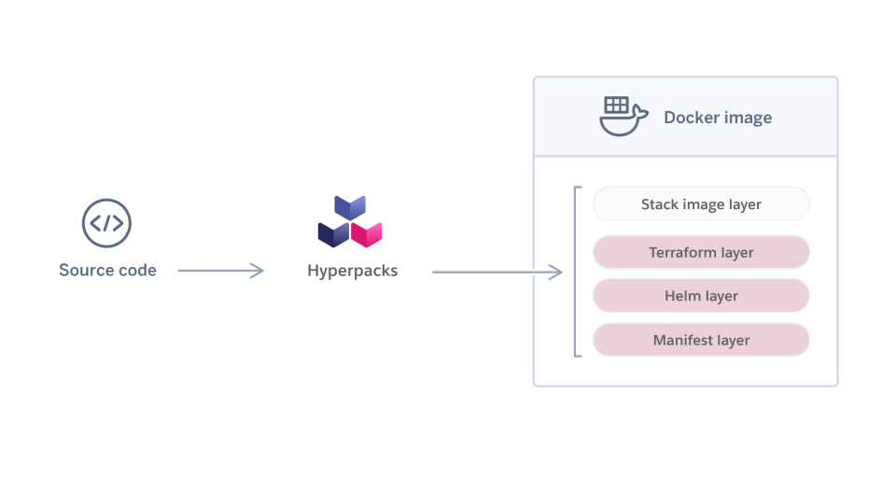
Example: Buildpacks
https://engineering.salesforce.com/hyperpacks-using-buildpacks-to-build-hyperforce/

Slide 37
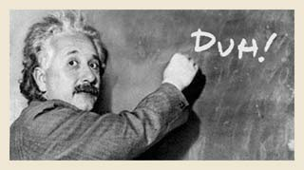
Meet Developers Where They Are
Use industry standard tooling
kubectl
Helm
Terraform
Argo
Buildpacks
The places we went wrong are almost always where we went bespoke

Slide 38

Reveal Complexity Gradually
The wrong abstractions create cliffs in the experience.
Aim to reveal complexity gradually, by giving developers the tools they need to access advanced features at the granularity that’s right for them.
Notes:
https://future.com/the-case-for-developer-experience/

Slide 39
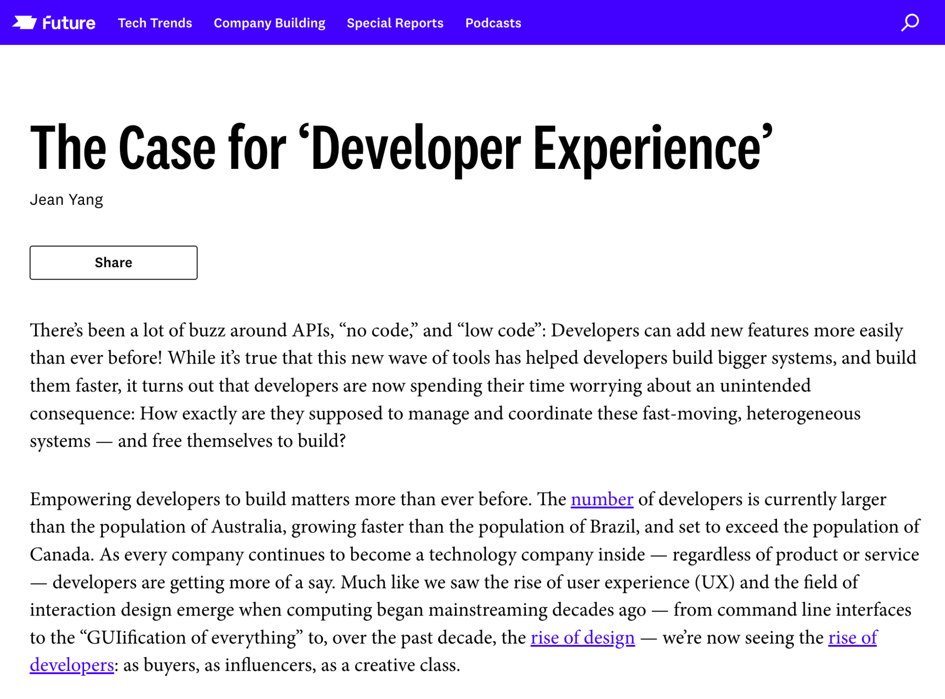
Reveal Complexity Gradually
“Abstraction, it is argued, is A Good Thing, because it makes it easier for everyone to create software. It is also the force behind the desire for that elusive silver bullet. But for developers working within real-world, messy ecosystems (as opposed to planned gardens), there’s a Dark Side of abstraction—that such silver bullets do not exist.”
https://future.com/the-case-for-developer-experience/
Notes:
https://future.com/the-case-for-developer-experience/

Slide 40
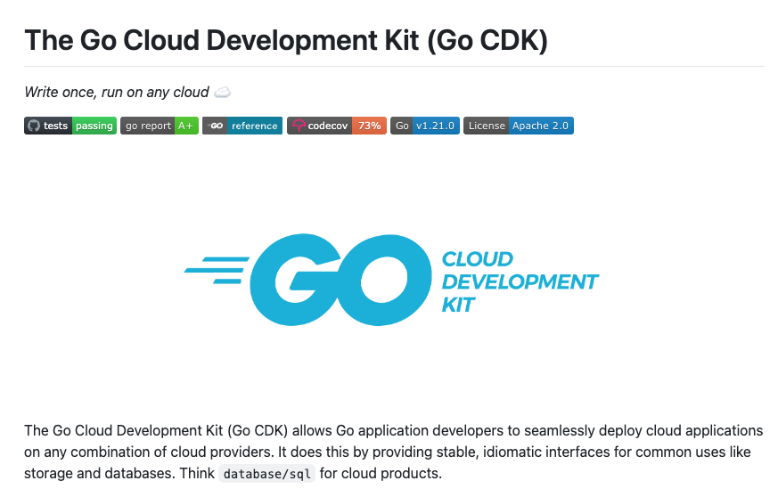
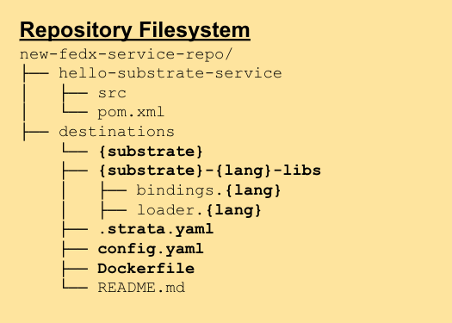
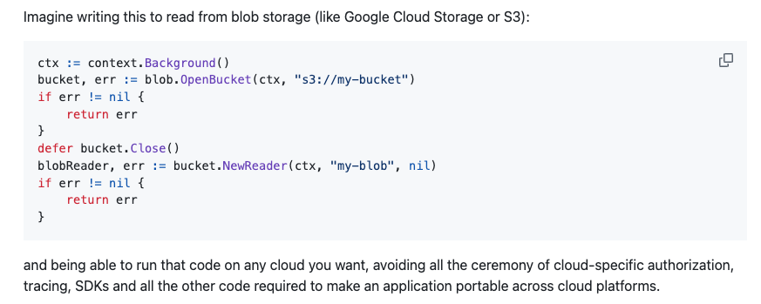
Reveal Complexity Gradually
Notes:
https://future.com/the-case-for-developer-experience/

Slide 41

Ephemeralization
“Do more and more, with less and less, until you can do everything with nothing”
Buckminster Fuller

Slide 42
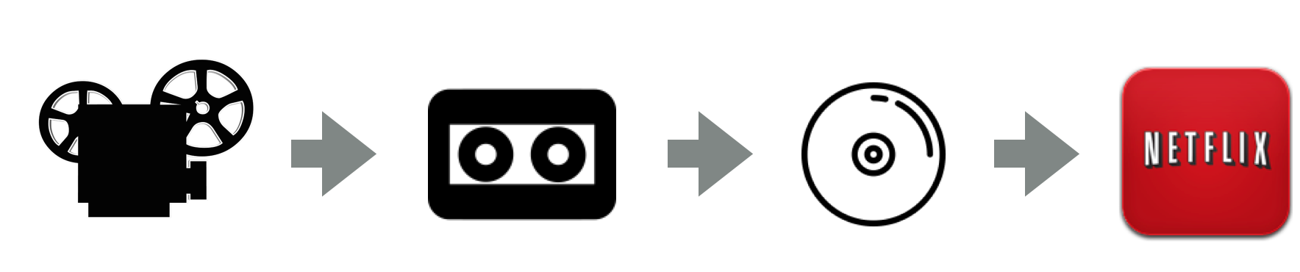
Example: Watching Movies

Slide 43
Ephemeralization
> git push heroku main

Slide 44
One Platform
humor
engine
CLI
GitOps
Web
Notifications
Buildpacks
Add-ons
APIs

Slide 45
One Platform
> falcon init
Creates a Github Repo (if one doesn’t exist)
Initializes a directory with GitOps configurations
Configures CI
Initializes Add-ons for Helm, Terraform, etc
Bootstraps Integration Test harness

Slide 46
One Platform
> git push falcon main
CI runs Buildpacks to generate Helm, Terraform, etc
Control Plane notified to publish configs
Platform goal seeks over those configs
Events are generated from each sub-system
Continuous Deployment begins when all configs have been realized.

Slide 47
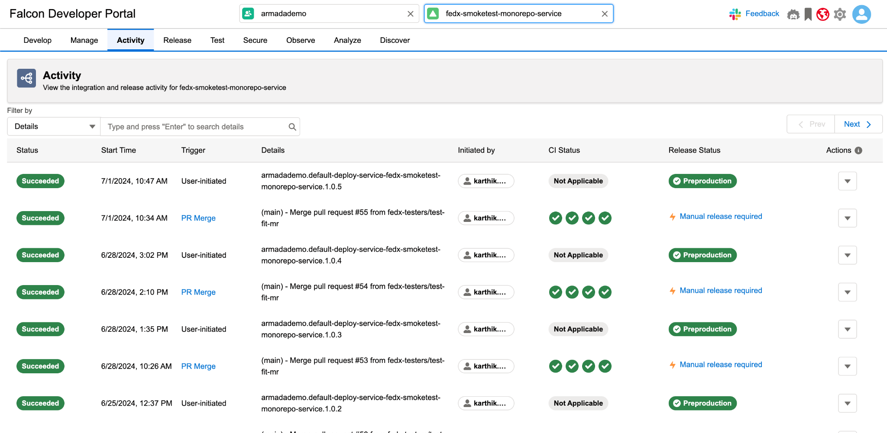
One Platform

Slide 48
One Platform
> falcon addons init <resource>
User runs the command for rds, s3, dynamodb, etc
CLI Prompts the developer with a few questions (like the name of the database)
Generates a manifest that defines what not how
CI unfurls the Add-on to generate Terraform, pipelines, security configs, etc

Slide 49
One Platform
85%
Faster Onboarding
6x
Faster Inner Loop Cycle Time
55%
Reduction to Release Failures

Slide 50
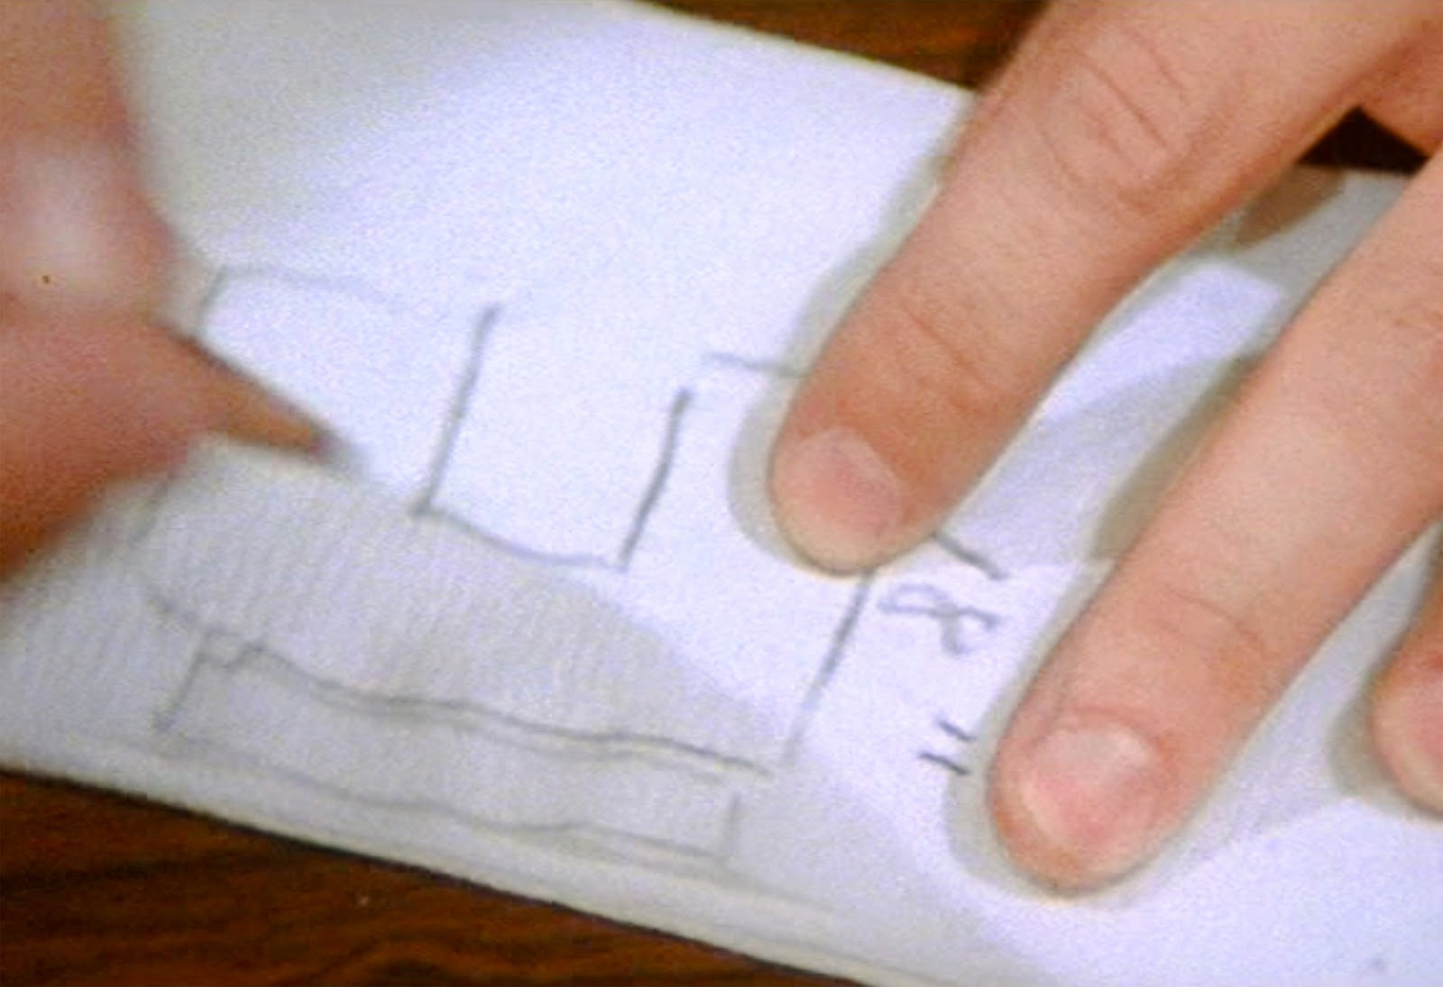
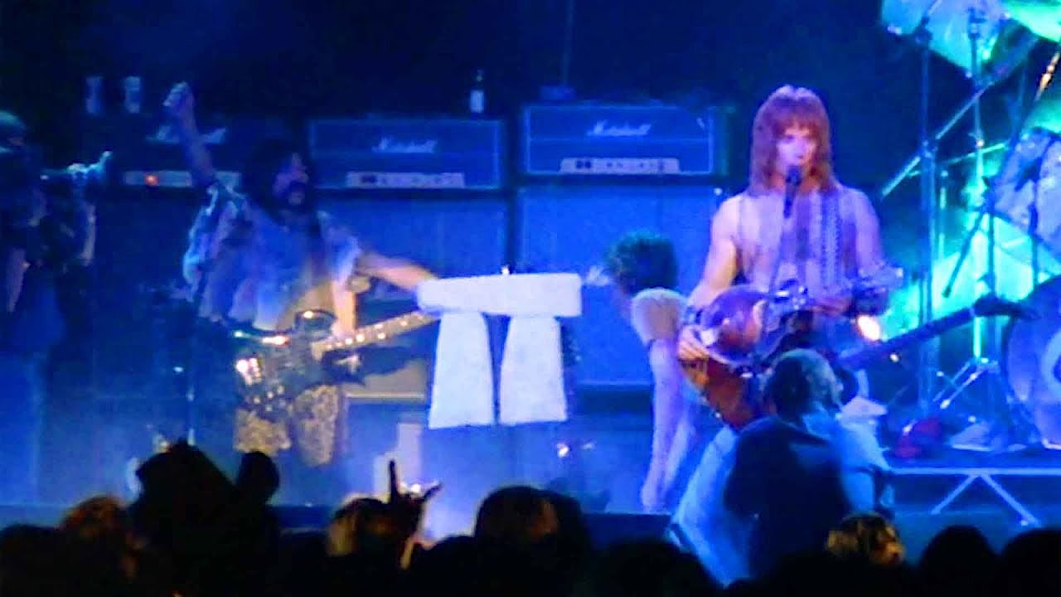

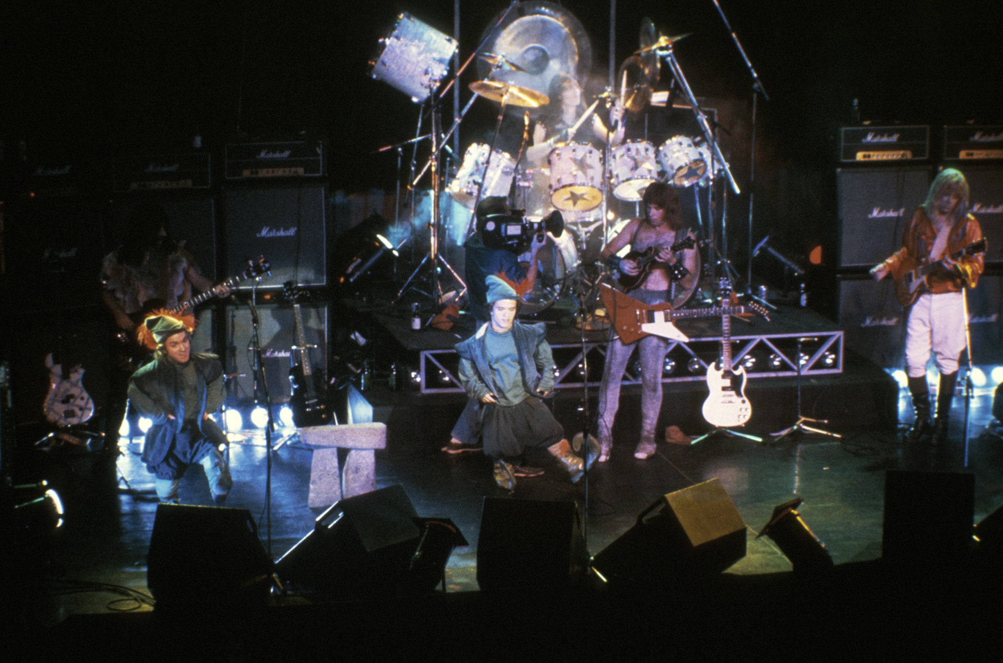
ALWAYS CHECK YOUR MEASUREMENTS

Slide 51
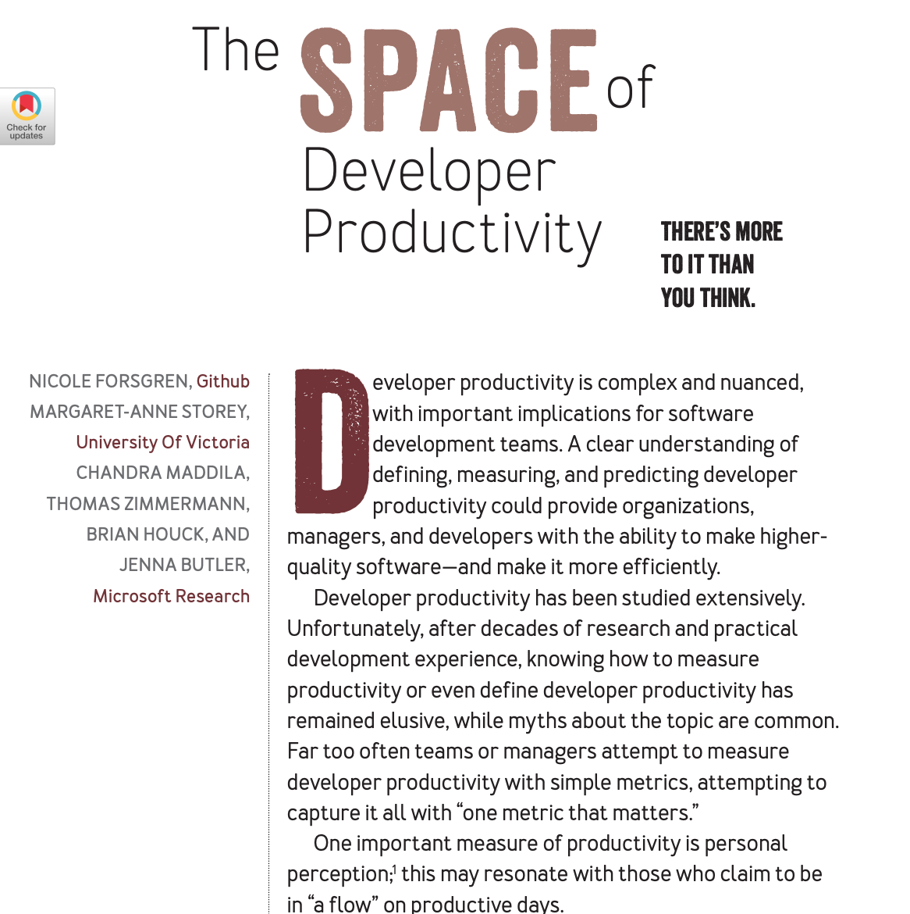
How do we measure developer productivity?
“The most important takeaway from exposing these myths is that productivity cannot be reduced to a single dimension (or metric!)”
https://dl.acm.org/doi/10.1145/3454122.3454124
Notes:
https://queue.acm.org/detail.cfm?id=3454124
https://dl.acm.org/doi/10.1145/3454122.3454124

Slide 52
SPACE
Satisfaction
Productivity
Activity
Collaboration
Efficiency
Notes:
Satisfaction
Productivity
Activity
Collaboration
Efficiency

Slide 53
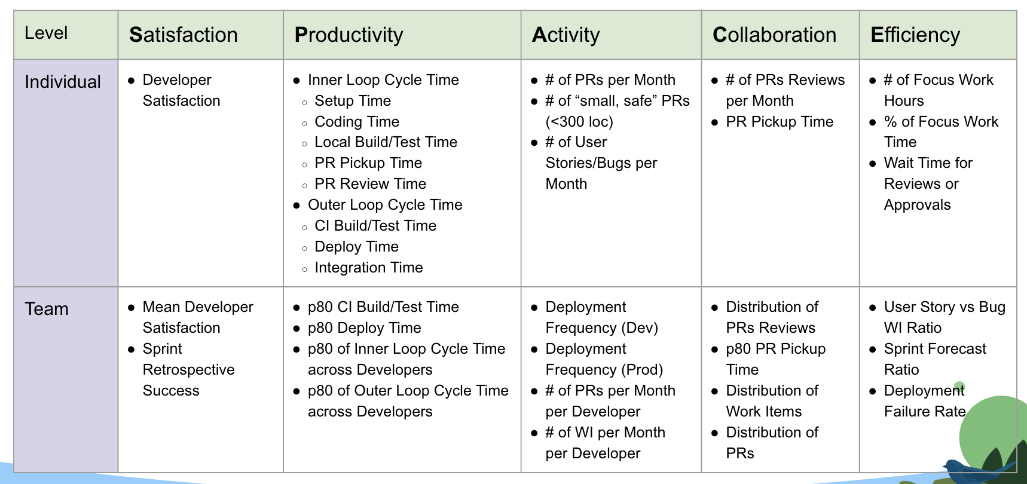

Slide 54
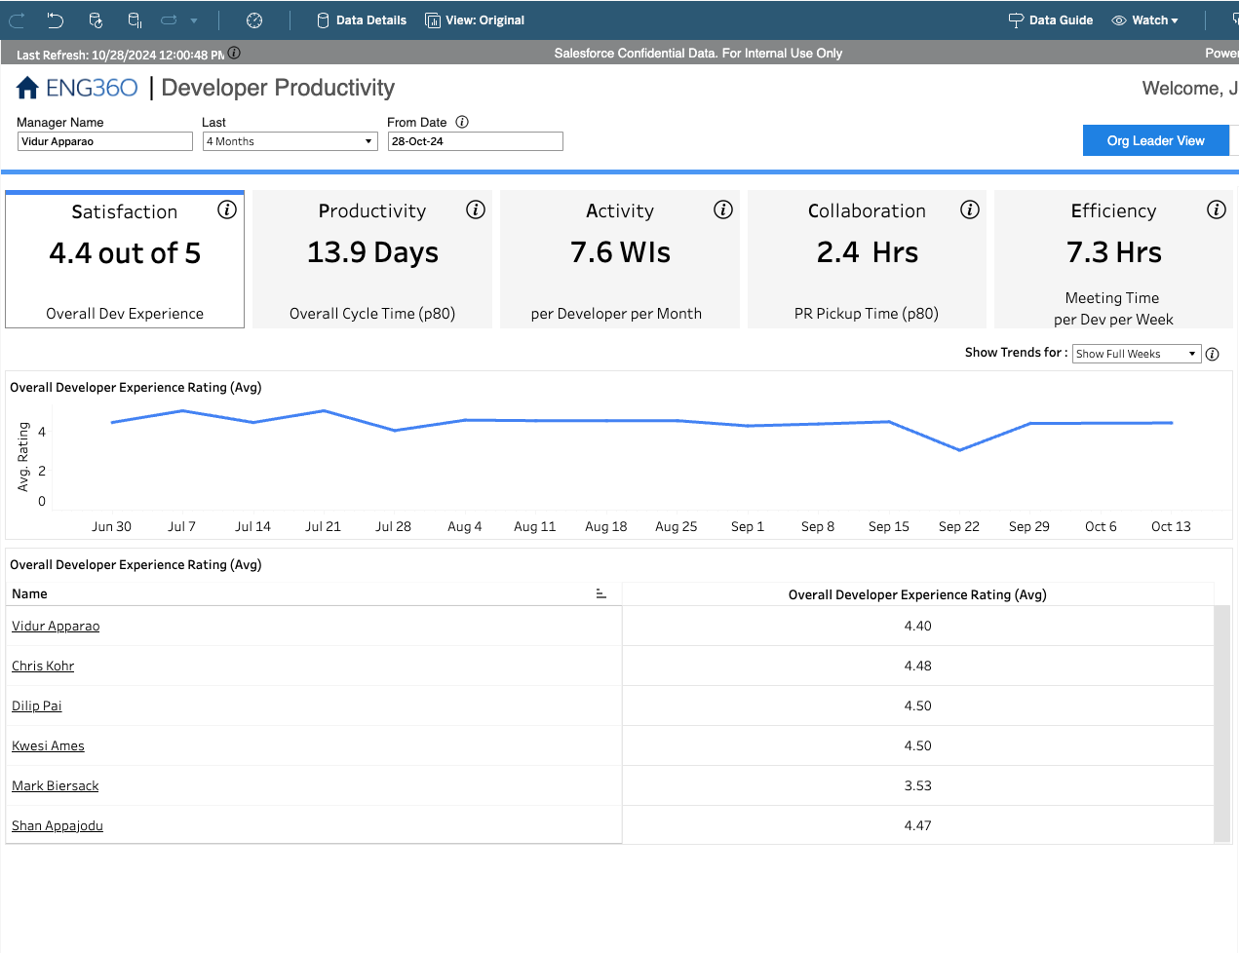
Individual
Developer Satisfaction Surveys
Team
Sprint Retro Success

Slide 55
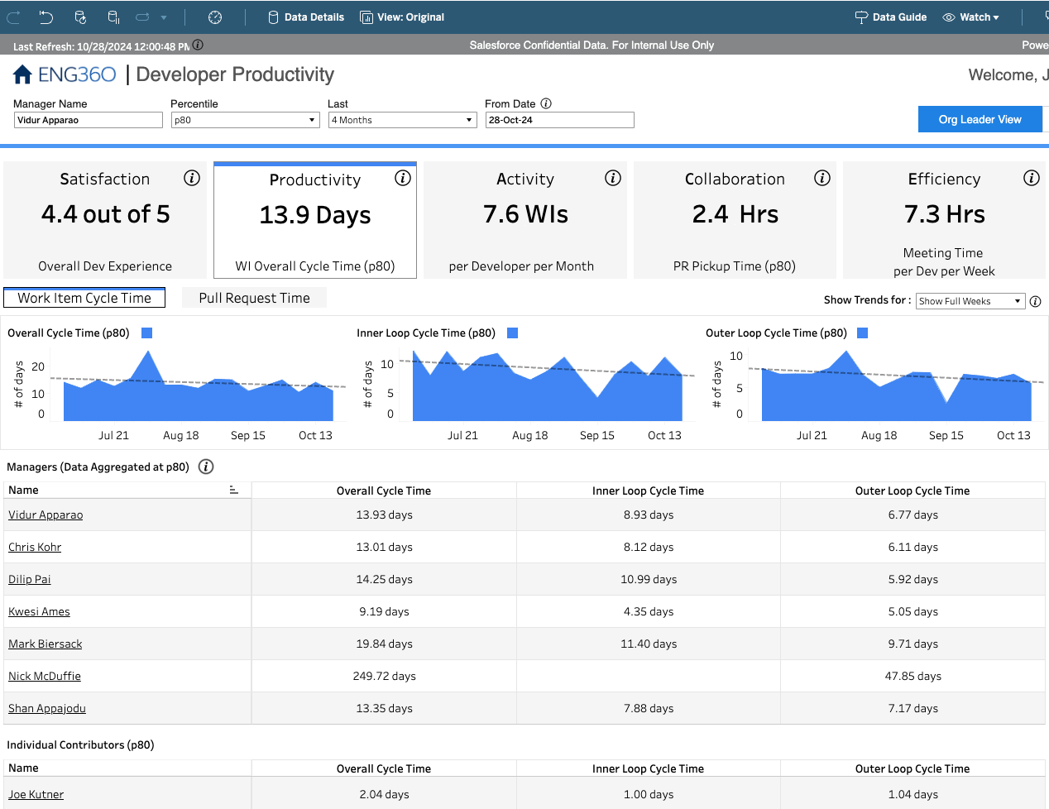
Individual
Inner-loop Cycle Time
Outer-loop Cycle Time
Team
p80 CI Build Time
p80 Deploy Time

Slide 56
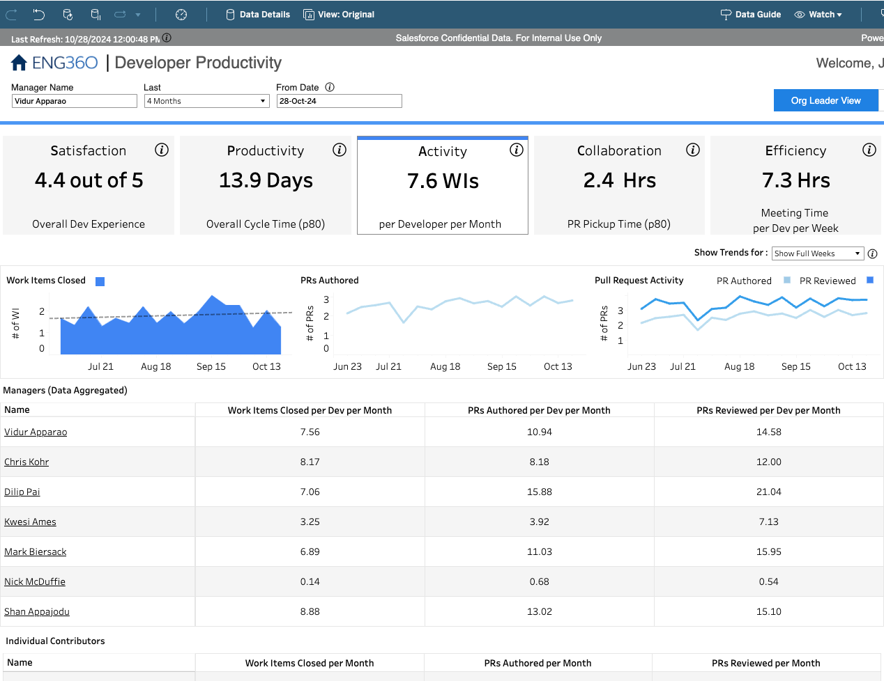
Individual
# of PRs
# of Bug Fixes
Team
Deployment Frequency

Slide 57
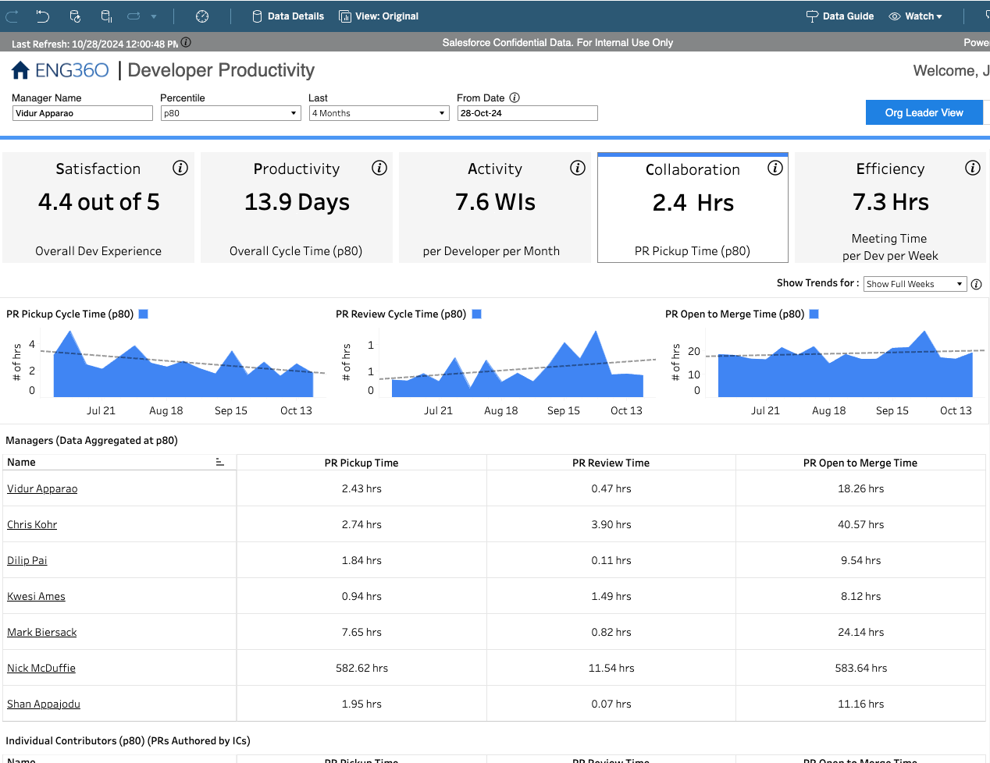
Individual
# of PR Reviews
PR Pickup Time
Team
Distribution of PR Reviews

Slide 58
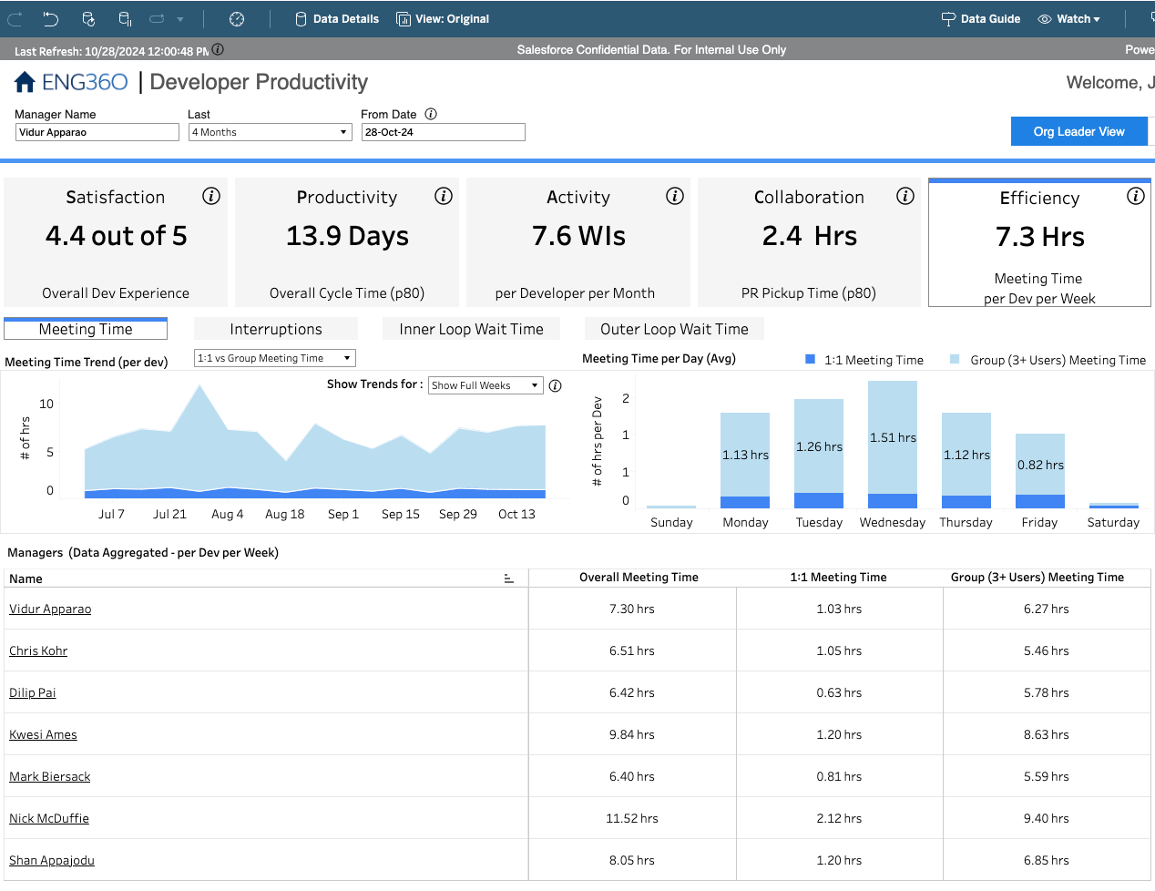
Individual
Focus Time
Wait Time for Reviews
Team
Deploy Failure Rate
Sprint Forecast Ratio

Slide 59

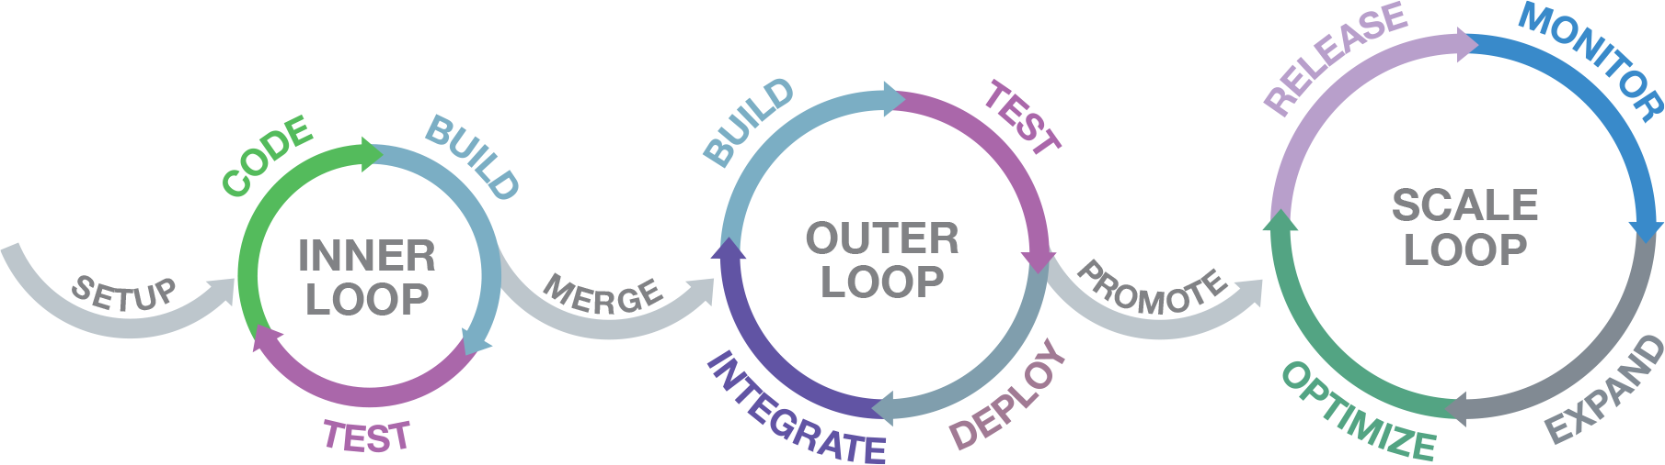
Inner-Loop Investment
Notes:
We focused on inner-loop tooling because cycle time (productivity) was so slow. Developers were waiting for long CI/CD processes to test simple changes, only to find out that they’d made a typo.
Give tools like Telepresence that can be used with a development environment have result in a 6x faster iteration speed for changes.

Slide 60
Recap
Values
Metrics
Unified Interfaces
Extension Points
Meet Developers Where They Are
Reveal Complexity Gradually
Ephemeralization
Satisfaction
Productivity
Activity
Collaboration
Efficiency

Slide 61

https://github.com/twelve-factor/twelve-factor/blob/main/CONTRIBUTING.md

Slide 62
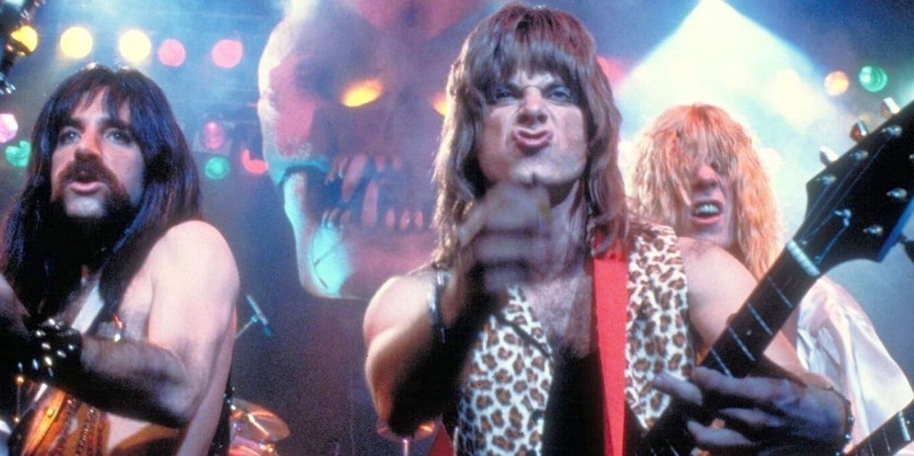
Thank You!

